Slide 1
Instructions (delete this slide)
Save this document with a new name before you begin work.
When adding a new slide, click on the small arrow next to “New Slide” on the toolbar. Select the layout that will best fit the content you want to add.
Change the layout of an existing slide: click the “Layout” button on the top toolbar to reformat your existing content to another master slide.
The dashed lines on the slide are guides. If you prefer to turn them off, go to the View menu, down to Guides and uncheck Guides.
Refer to utdallas.edu/brand for specific rules on using the University logos and wordmarks.
UTD_Dark.pptx

Slide 2

Secure Distributed Observers for a Class of Linear Time Invariant Systems in the Presence of Byzantine Adversaries
Jackson Reed and Jonas Wagner
MECH 6V29 – Multi-agent Robotic Systems – Paper
Other information, such as School or Department

Slide 4
$\frac{34}{23}$

Slide 5
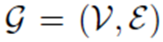
Notation
Typographic hierarchy
Footer information

Slide 6
Three-column layout
Structure
16-pt Header type
“Return” and “Tab” 14-pt type
“Return Tab” 11-pt type
“Return Tab” 11-pt type Bullets
“Return Tab” 11-pt type 2nd Level Bullets
“Shift Tab” to move backwards through the options
Footer information

Slide 7
Table
Displaying data
Table header | Table header | Table header
This is a text block where you can tab across and add copy | This is a text block where you can tab across and add copy | This is a text block where you can tab across and add copy
This is a text block where you can tab across and add copy | This is a text block where you can tab across and add copy | This is a text block where you can tab across and add copy
This is a text block where you can tab across and add copy | This is a text block where you can tab across and add copy | This is a text block where you can tab across and add copy
This is a text block where you can tab across and add copy | This is a text block where you can tab across and add copy | This is a text block where you can tab across and add copy
Footer information

Slide 8
Column chart (single category)
Displaying data
Callout example
Callout example
Right-click the chart and select “Edit Data in Excel” to customize the values.
Footer information

Slide 9
Column chart (multi-category)
Displaying data
Callout example
Callout example
Right-click the chart and select “Edit Data in Excel” to customize the values.
Footer information

Slide 10
Stacked column chart
Displaying data
Callout example
Callout example
Right-click the chart and select “Edit Data in Excel” to customize the values.
Footer information

Slide 11
Bar chart
Displaying data
Callout example
Callout example
Right-click the chart and select “Edit Data in Excel” to customize the values.
Footer information

Slide 12
Line chart
Displaying data
Callout example
Callout example
Right-click the chart and select “Edit Data in Excel” to customize the values.
Footer information

Slide 13
Pie chart
Displaying data
Callout example
Callout example
Right-click the chart and select “Edit Data in Excel” to customize the values.
Footer information

Slide 14

“We are incredible at remembering pictures. Hear a piece of information, and three days later you’ll remember 10 percent of it. Add a picture and you’ll remember 65 percent.”
John Medina
Author of Brain Rules
You can leave this background orange or add a subtle background photo using the directions from the title slide. Right-click on the image and select Change Picture to change.

Slide 15
“We are incredible at remembering pictures. Hear a piece of information, and three days later you’ll remember 10 percent of it. Add a picture and you’ll remember 65 percent.”
John Medina
Author of Brain Rules
You can leave this background orange or add a subtle background photo using the directions from the title slide. Right-click on the image and select Change Picture to change.

Slide 16
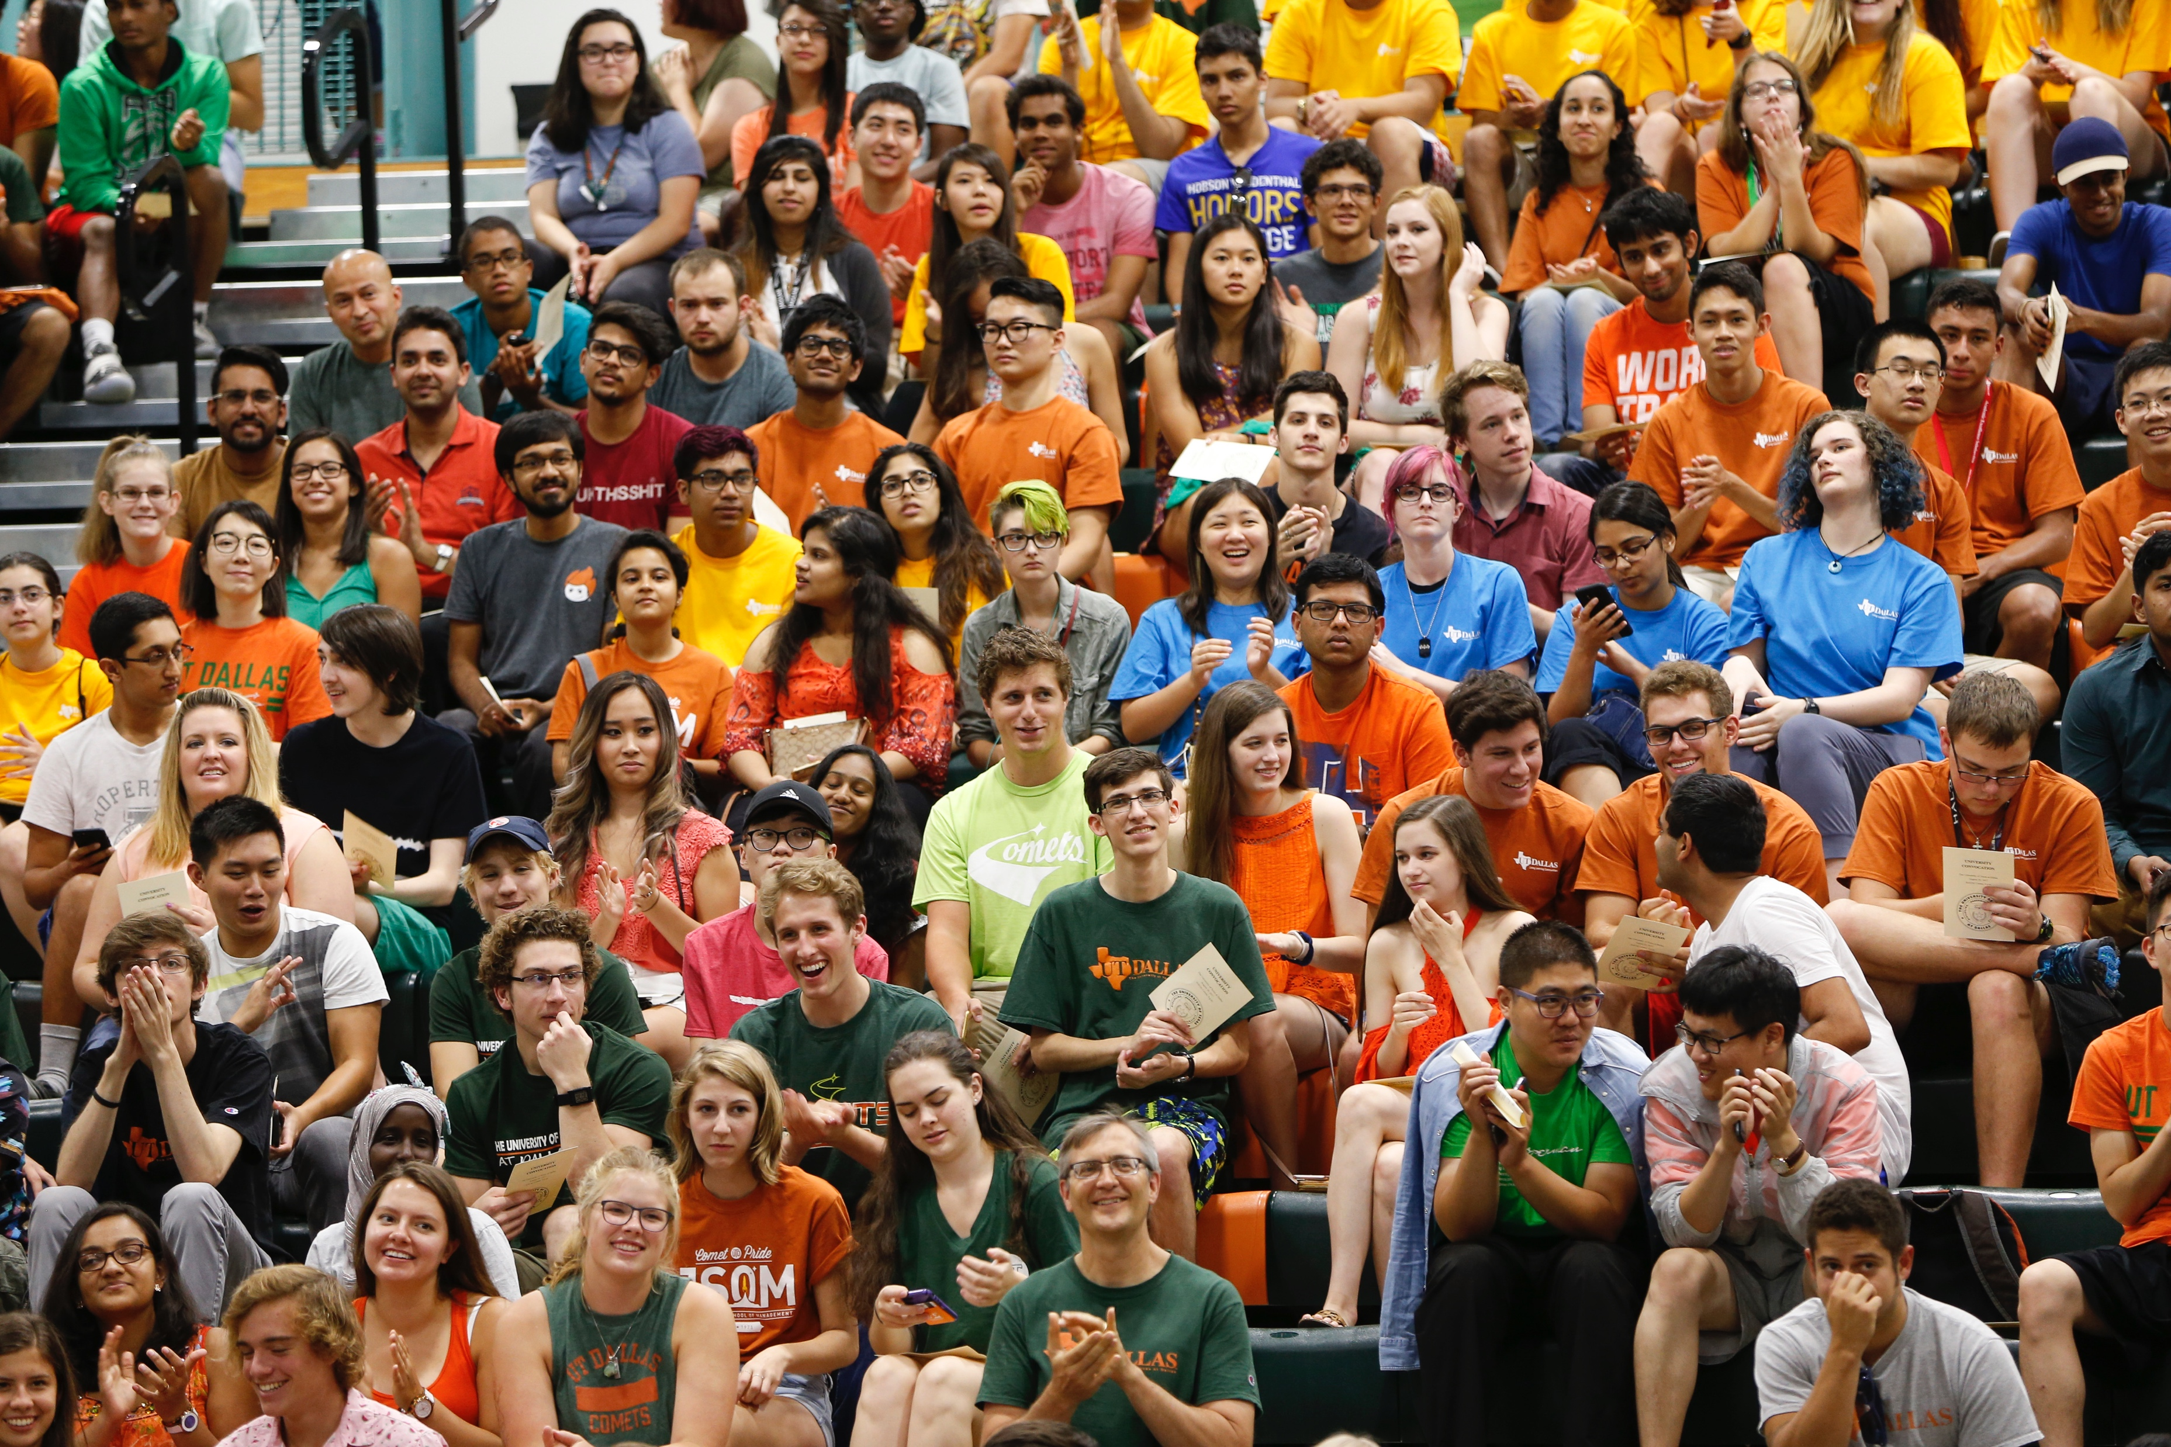

UT Dallas Enrollment
Our student body has seen a 163% increase in 9 years.
Footer information
Notes:
Example Slide – 3 columns

Slide 17
UT Dallas Enrollment
Upward Trajectory: example slide
Our student body has seen a 163% increase in 9 years
Footer information
Notes:
Example Slide – 2 columns

Slide 18
Quote slide style example layout. Text should be sentence case.
First, Last Name
Company name
Title comes here
Notes:
Quote slide without photo background

Slide 19
Callout style examples
Text Here
Text Here
Text Here
Text Here
Text Here
Text Here
Text Here
Text Here
Footer information
Notes:
Copy and paste these onto various slides to highlight main points

Slide 20








UT Dallas Marks

Slide 21
Section head
Overview of the section
Use to segue to another section
Use as a Q&A slide

Slide 23

Thank you
Contact information or summary
More details concerning the brand standards for UT Dallas can be found online at utdallas.edu/brand.

